Slide 1
Cross-Platform Mobile Application Development
B.Sc. Web Technologies & Programming
Department of Computer Science & Applied Physics

Slide 2
Version Control
Version control is a method of recording changes to a file or set of files over time so that you can recall specific versions later.
Why would you need Version Control?
Keep track of changes over time
Can revert back to a previous version
See who modified a particular version

Slide 3
Version Control Techniques
Manual
Copy files into different date-stamped folders
Pros:
Very Simple
Cons:
Very Error prone

Slide 4
Version Control Techniques
Local Version Control
E.g. Revision Control Sytem (RCS). Keeps the latest version of the file and backward deltas so that previous versions can be accessed.
Pros
Automated database system, where old versions don’t become “lost”.
Cons
Not good for collaboration.

Slide 5
Version Control Techniques
Centralized Version Control
E.g. Concurrent Versioning System (CVS). A single server contains all the versioned files, and a number of clients check out files from that central place.
Pros
Enables collaborative working.
Cons
Single Point of Failure (SPOF)

Slide 6
Version Control Techniques
Distributed Version Control
E.g. GitHub. Rather than a single, central repository on which clients synchronize, each person’s working copy of the codebase is a complete repository.
Pros
Each copy is a remote backup, therefore protects against data loss.
Allows participation in projects without requiring permissions from project authorities.
Cons
Slightly more complex.

Slide 7
Git and GitHub
Git is a version control system that runs on the command line on your local machine.
It allows the user to keep track of files and changes to the files in a repository.
Git can coordinate with another Git on another machine.

Slide 8
Git and GitHub
GitHub is a central Git repository hosting service.
Users can “push” changes of their files to the GitHub repository.

Slide 9
Git Commands
Git clone <repository>
Creates a copy of the repository (from Git or GitHub) with the same name as the repository
Git status
Gets the current status of the repository

Slide 10
Git Commands
Git add <file>
Adds a new (or updated) file to the local repository
Git add .
Adds all files to the local repository

Slide 11
Git Commands
Git commit –m “update comment”
Commits any added changes to the local repository with a one line comment

Slide 12
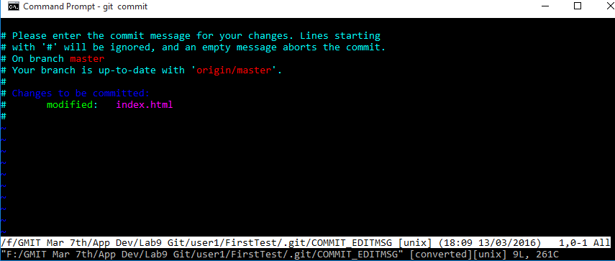
Git Commands
Git commit
Commits any added changes to the local repository.
Also opens a vi editor to allow you to enter a multi line commit comment.
Press ‘I’ (for insert) to start typing the comment.
Press the Escape key then :wq to save the comment.

